Slide 1
Detecting Anomalies in Streaming Graphs
SpotLight
Dhivya Eswaran
Christos Faloutsos
Sudipto Guha
Nina Mishra
Carnegie Mellon University
Amazon
This work was performed at Amazon.

Slide 2


Graphs are being created everywhere
INTRODUCTION
………
………
………
6 Jun 2018, 1.34am
………
………
You
Alice
………
………
………
………

Slide 3

Many other settings…
INTRODUCTION
Computer networks
IM/e-mail networks
Transportation networks
Edit networks

Slide 4

As a sequence of graph snapshots
INTRODUCTION
MORNINGS
Monday AM
Tuesday AM
Wednesday AM
time
Monday PM
Tuesday PM
NIGHTS

Slide 5

But sometimes unusual events happen
INTRODUCTION
Tax scam
Normal
Network failure

Slide 6
INSIGHT

Slide 7



Anomalies tend to involve…
INSIGHT
sudden (dis)appearance of
large dense directed subgraph
the sudden (dis)appearance of
large dense directed subgraph

Slide 8
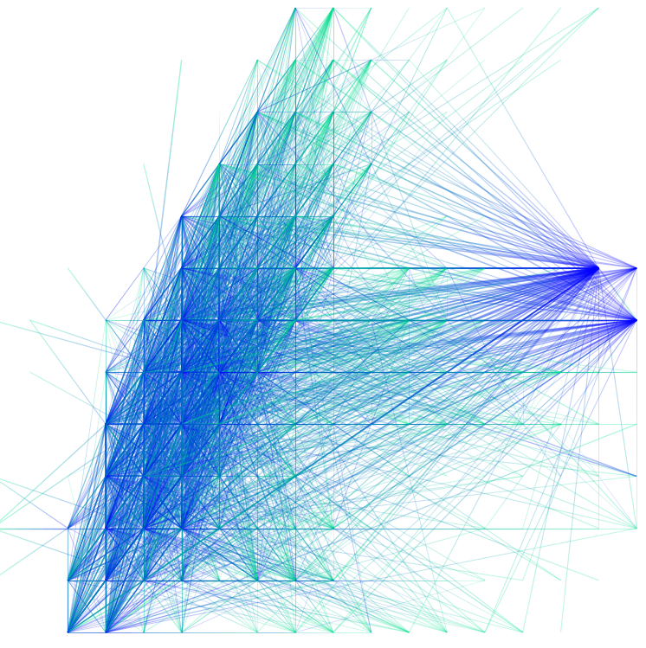

sudden (dis)appearance of
large dense directed subgraph
INSIGHT
destinations
destinations
sources
sources

Slide 9


sudden (dis)appearance of
large dense directed subgraph
TEXT
destinations
many nodes
many many edges
sources

Slide 10
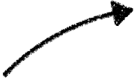
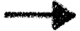
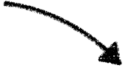

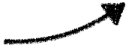
sudden (dis)appearance of
large dense directed subgraph
INSIGHT
steady evolution?
sudden
initial
final

Slide 11

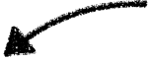
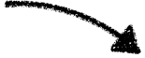
sudden (dis)appearance of
large dense directed subgraph
INSIGHT
appearance
disappearance

Slide 12

PROBLEM

Slide 13

PROBLEM
Ok!
Ok!
time
Ok!
anomaly!
STREAMING MODEL
ALGORITHMIC CONSTRAINTS
Real-time and fast detection
Bounded working memory
(Un)directed weighted edges
Time-evolving node set
Known node-correspondence

Slide 14
ALGORITHM

Slide 15

Overview of SpotLight
ALGORITHM
anomaly!
v(G3)
v(G3)
Graph
Sketching
Anomaly
Detection
G1
G2
v(G1)
v(G1)
v(G2)
v(G4)
v(G2)
v(G4)
G3
G4
Many off-the-shelf methods for anomaly detection:
Robust Random Cut Forests [Guha, Mishra, Roy & Schrijvers; ICML 2016]
Light-weight Online Detector of Anomalies [Pevny; ML 2016]
Randomized Space Forests [Wu, Zhang, Fan, Edwards & Yu; ICDM 2014]

Slide 16
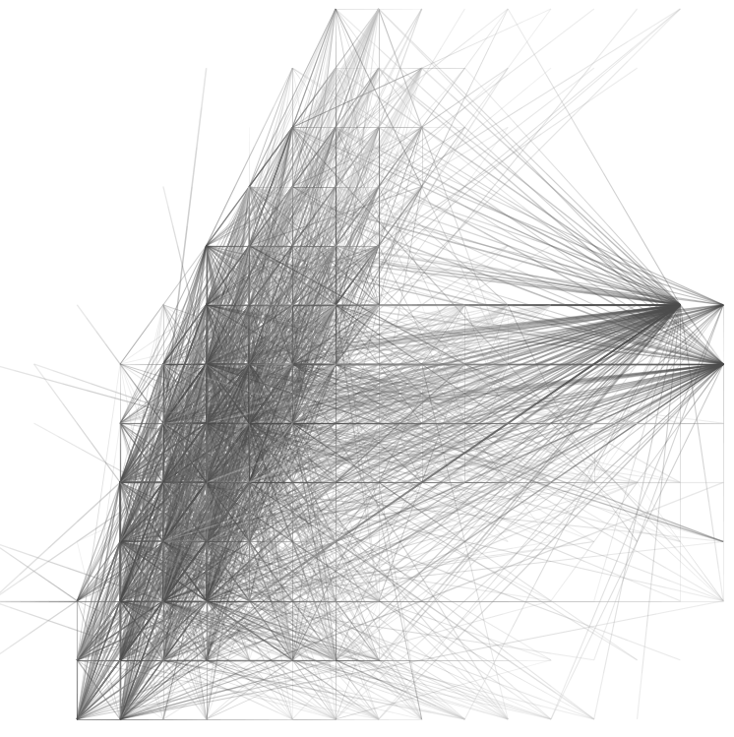



SpotLight randomized graph sketching
ALGORITHM
0
100
20
THREE PARAMETERS:
Probability of sampling source ‘p’
Probability of sampling destination ‘q’
Number of sketching dimensions ‘K’
Locality-aware
Tunable sketch size
“Process-and-discard” edges
Theoretical guarantees

Slide 17

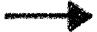
SpotLight at work on a stream
ALGORITHM
Hashes: hS, hS, hS: src → {1,.., 1/p} & hD, hD, hD: dst → {1,.., 1/q}
b
c
a
a
b
1
2
2
1
1
a
b
d
a
c
time
5pm
6pm
7pm
hS hS hS
hD hD hD
hS hS hS
hD hD hD
hS(a) = 1
hS(a) ≠ 1
hS(a) = 1
hD(b) ≠ 1
hD(b) ≠ 1
hD(b) = 1
a
b
b
c
hS(b) ≠ 1
hS(b) = 1
hS(b) = 1
hD(c) = 1
hD(c) = 1
hD(c) = 1
STREAMING ANOMALY DETECTOR
anomaly score
0
0
0
0
0
0
2
0
1
3
0
0
0
0
0
2
0
1
5-6pm
6-7pm
time

Slide 18
EXPERIMENTS

Slide 19

The labeled DARPA dataset
EXPERIMENTS
4.5M edges in 87.7K time ticks
9.5K sources, 24K destinations
Edges labeled as attack/not
Stream of 1.5K hourly graphs
(24% anomalous)
Notes:
animations

Slide 20
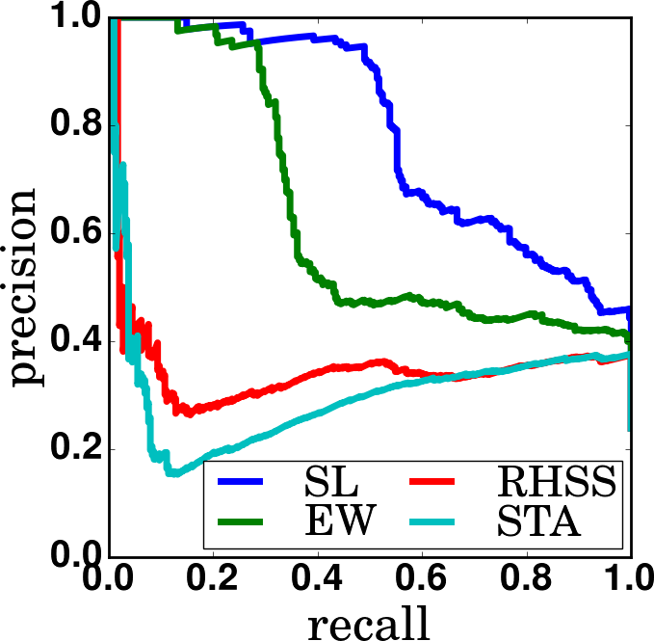
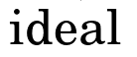
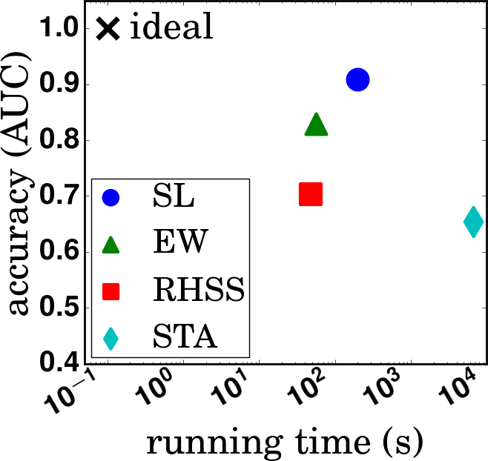
DARPA: Precision and recall
EXPERIMENTS
#graphs correctly flagged
Precision =
#graphs flagged
#graphs correctly flagged
Recall =
#anomalous graphs
RHSS: (Ranshous, Harenburg, Sharma & Samatova, SDM 2016)
STA: Streaming Tensor Analysis (Sun, Tao & Faloutsos, KDD 2006)
SL = SpotLight (proposed)
EW = Edge Weight = SpotLight with K=p=q=1
RHSS = Edge likelihood function based on previous occurrence, preferential attachment and triangle closing
STA = Streaming Tensor Analysis, a spectral method

